Slide 1
Verification and Validation of a
Monolithic Fluid-Structure Interaction Solver in FEniCS

Slide 2
Objectives
Implement a fluid-structure interaction solver by the finite element method
Compare the impact of mesh lifting operators
Improve computational efficiency of the implementation

Slide 3
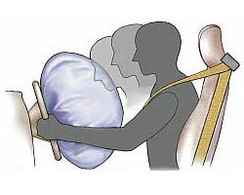
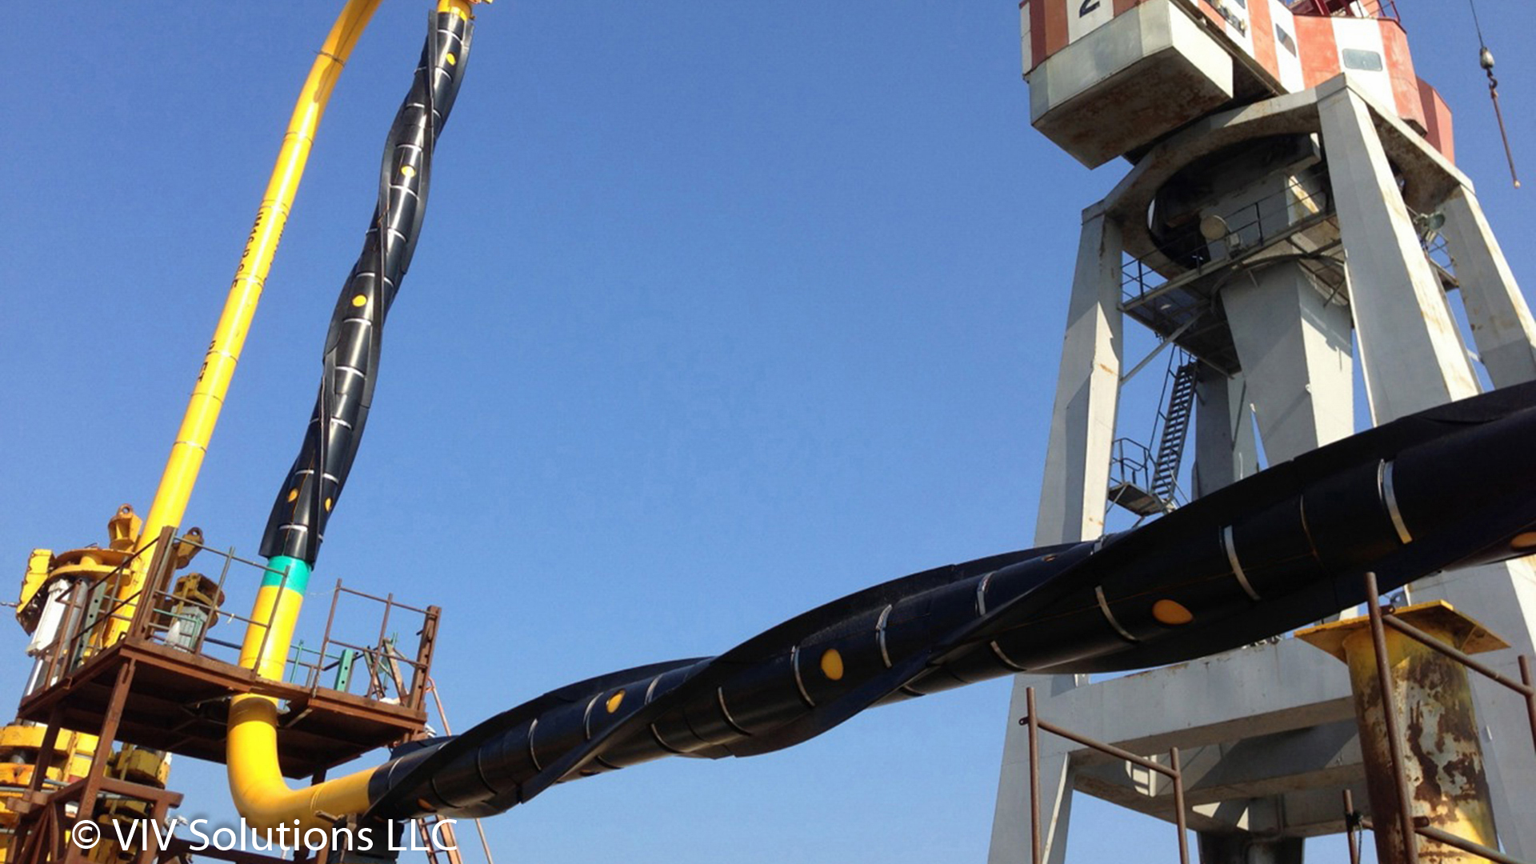
Fluid-structure interaction
Fish swimming
Bending of a tree
Engineering applications
Airbag development
Subsea jumper design

Slide 4
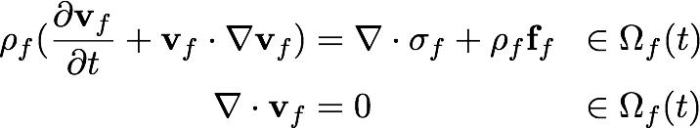
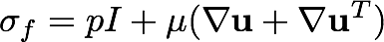
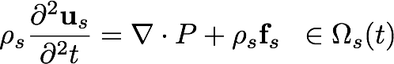
Governing equations
Fluid - Eulerian description of motion
Structure - Lagrangian description of motion
P is the first Piola-Kirchhoff stress tensor

Slide 5
Tracking the interface
Does not share the same description of motion
The fluid and solid domain will not match at the interface
Redefined of a transformed coordinate system

Slide 6
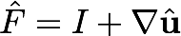
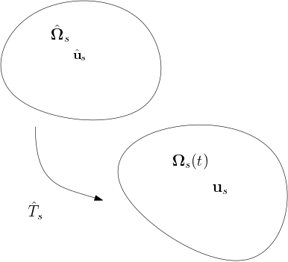
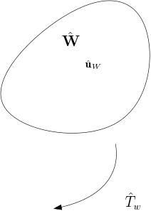
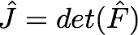
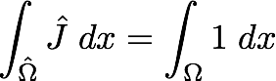
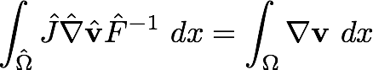
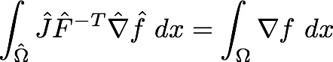
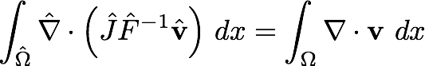
Arbitrary Lagrangian-Eulerian
The solid is defined in the Lagrangian description of motion
The fluid is mapped on an artificial coordinate system «similar» to the Lagrangian

Slide 7
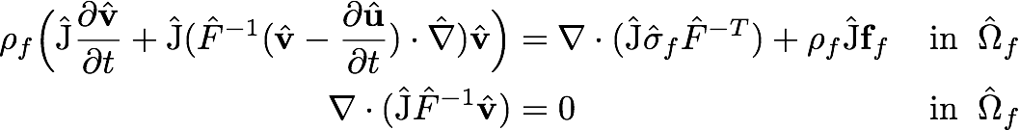
Navier-Stokes in ALE
The interface is tracked easily
Degeneration of mesh due to large deformations
Auxiliary equations needed to ensure a smooth evolution of fluid mesh cells

Slide 8
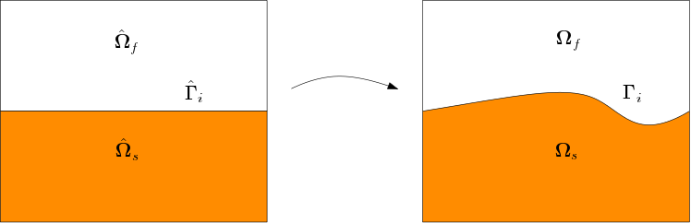
Interface Conditions
Kinematic boundary condition
Dynamic boundary condition
Geometric boundary condition

Slide 9
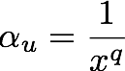
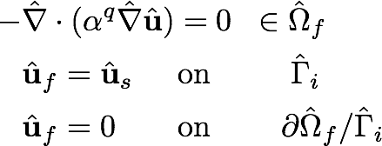
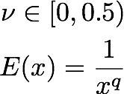
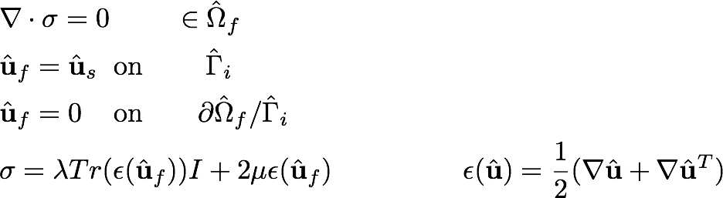
Mesh lifting operators
Mesh regularity vs computational efficiency
Laplacian
Linear elasticity

Slide 10
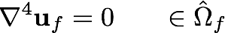
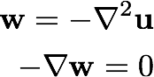
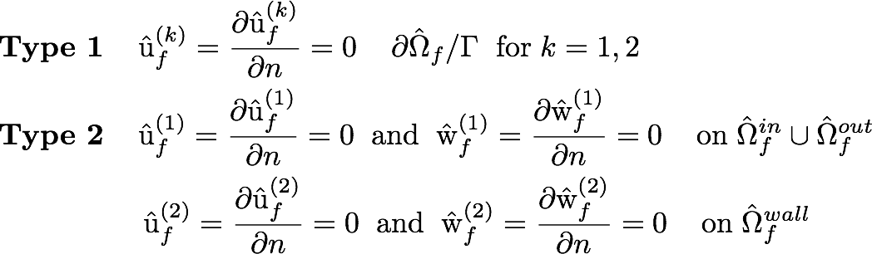
Mesh lifting operators
Biharmonic operator

Slide 11
Verification

Slide 12
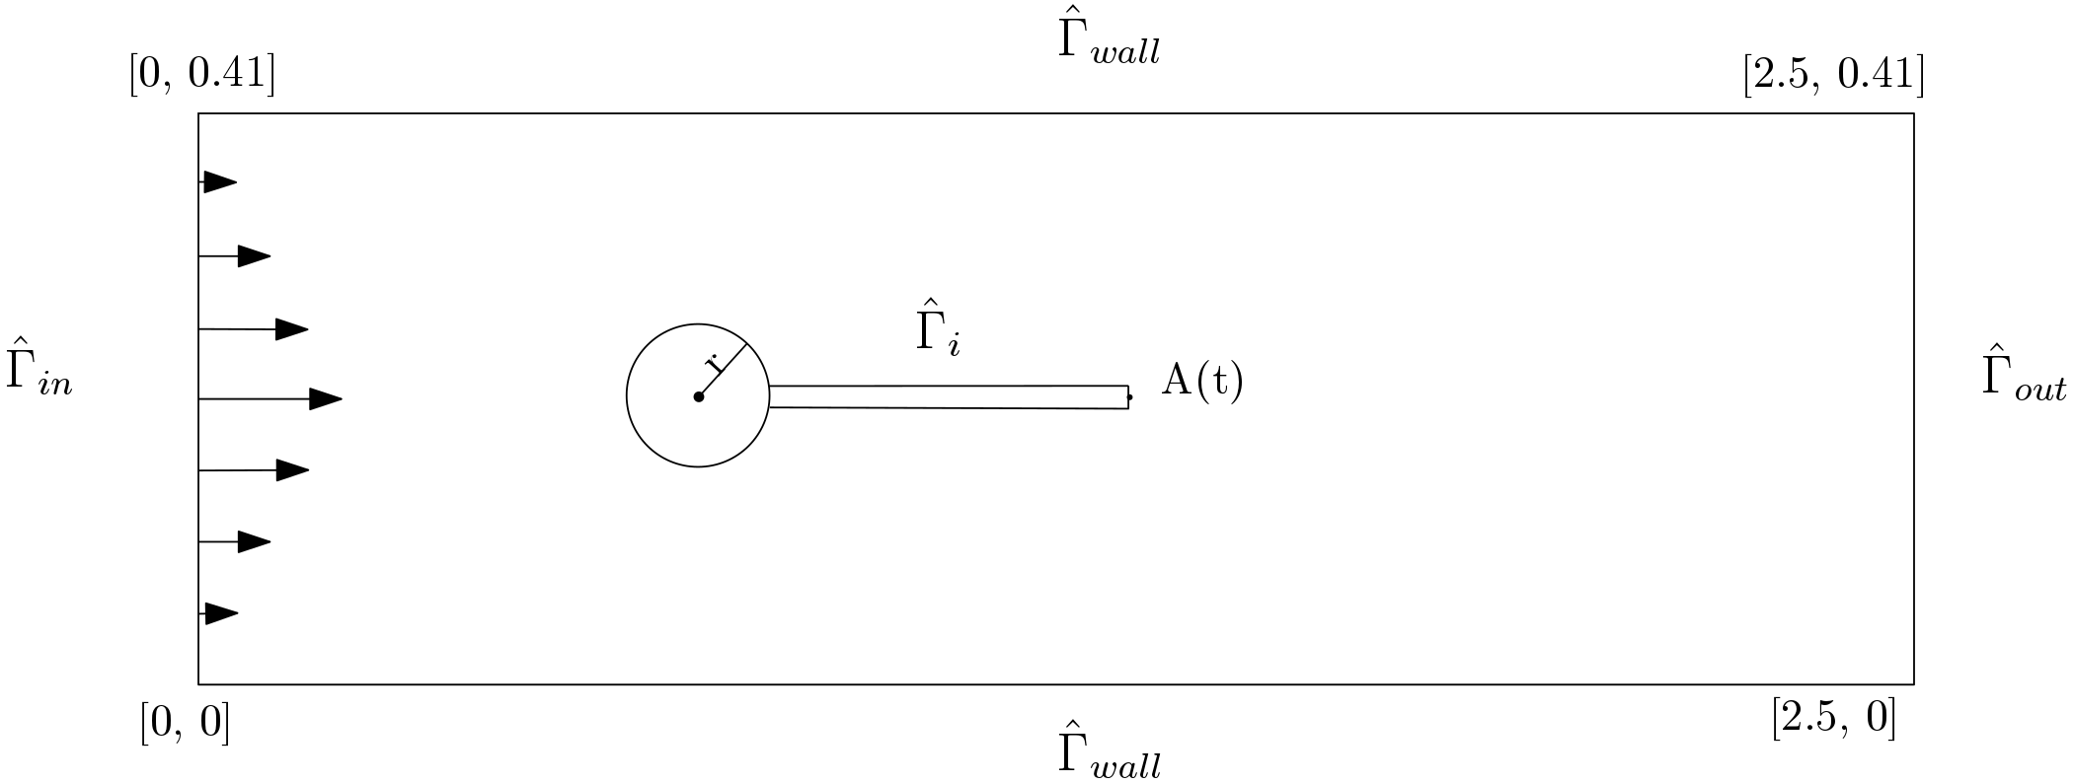
Validation
Turek Benchmark¹
Interaction between a elastic flag and laminar/transient fluid flow
¹ Jaroslav Hron and Stefan Turek. Proposal for numerical benchmarking of fluidstructure

Slide 13
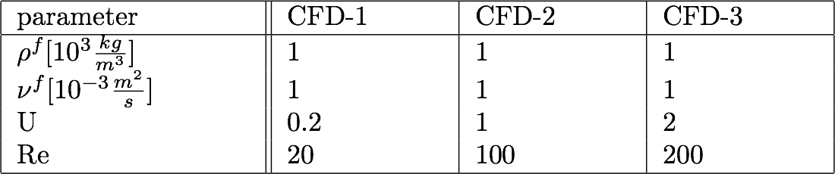
CFD
Laminar/Transient flow
Evaluation of lift and drag on the inner geometry

Slide 14
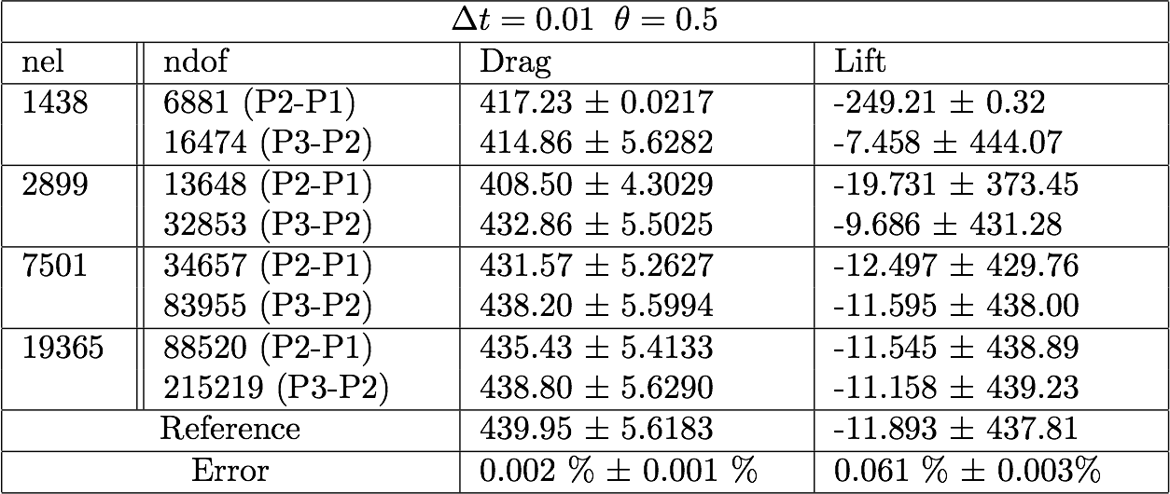
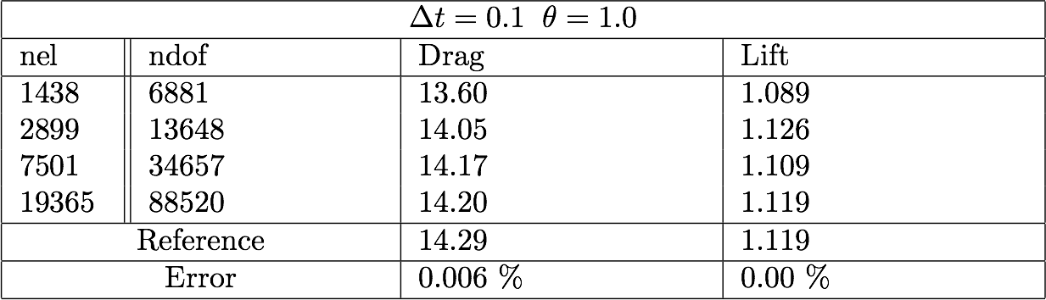

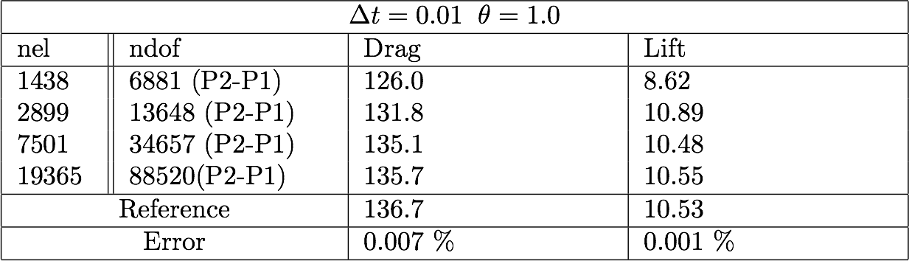
CFD
CFD-1
CFD-3
CFD-2

Slide 15
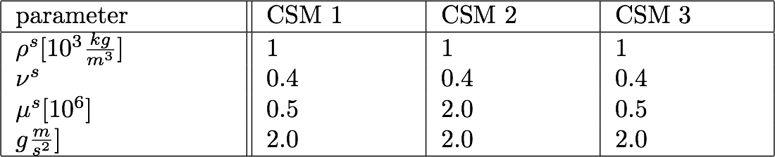
CSM
Large deformations
Deformation of the elastic flag
Finite-element pair

Slide 16
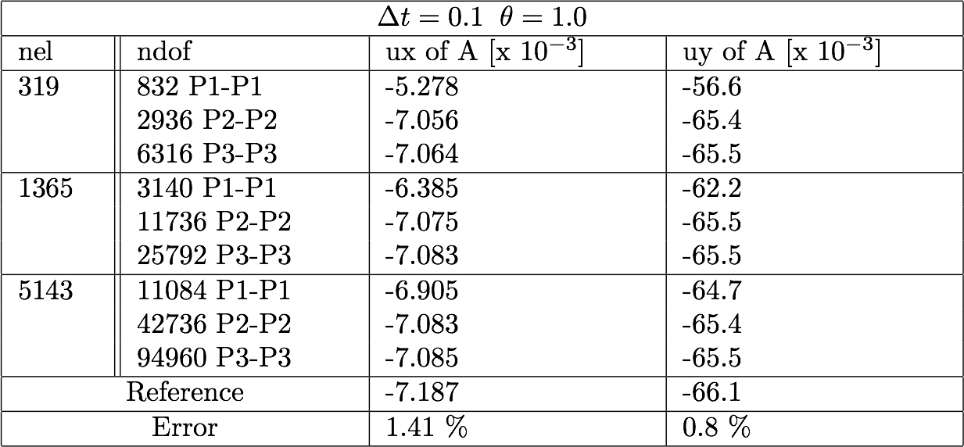
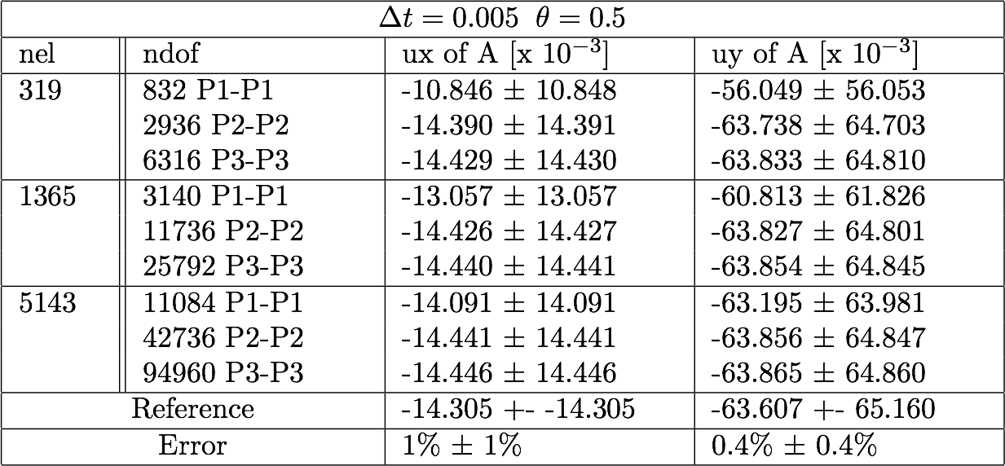
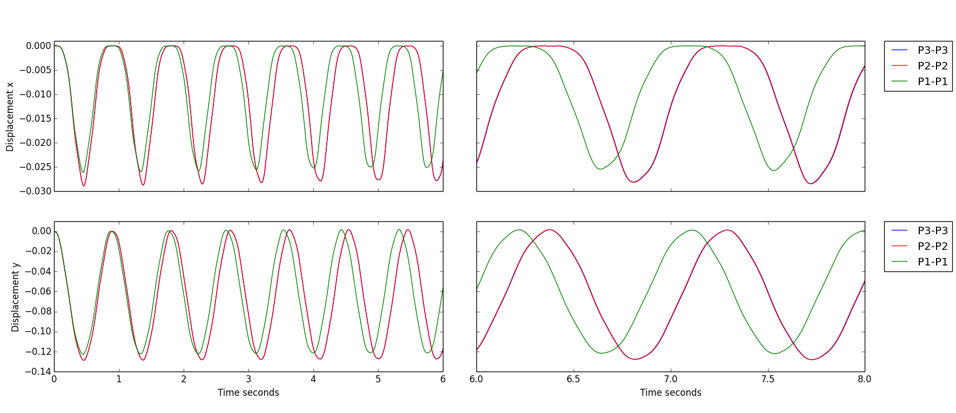
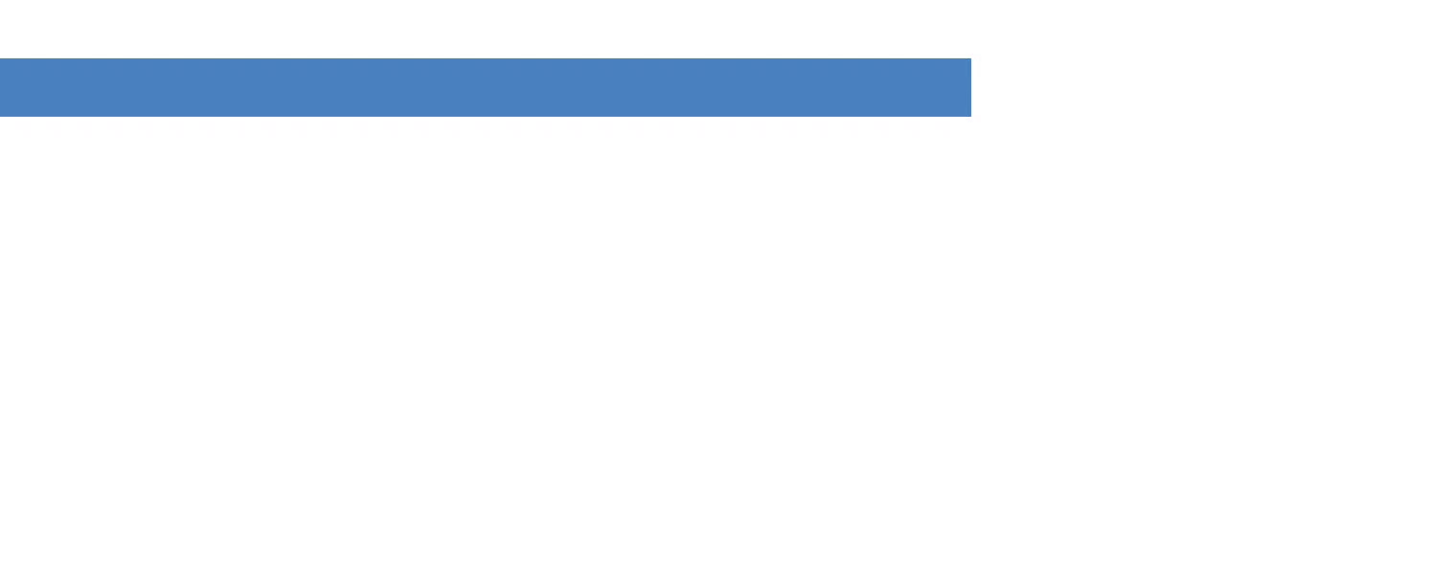
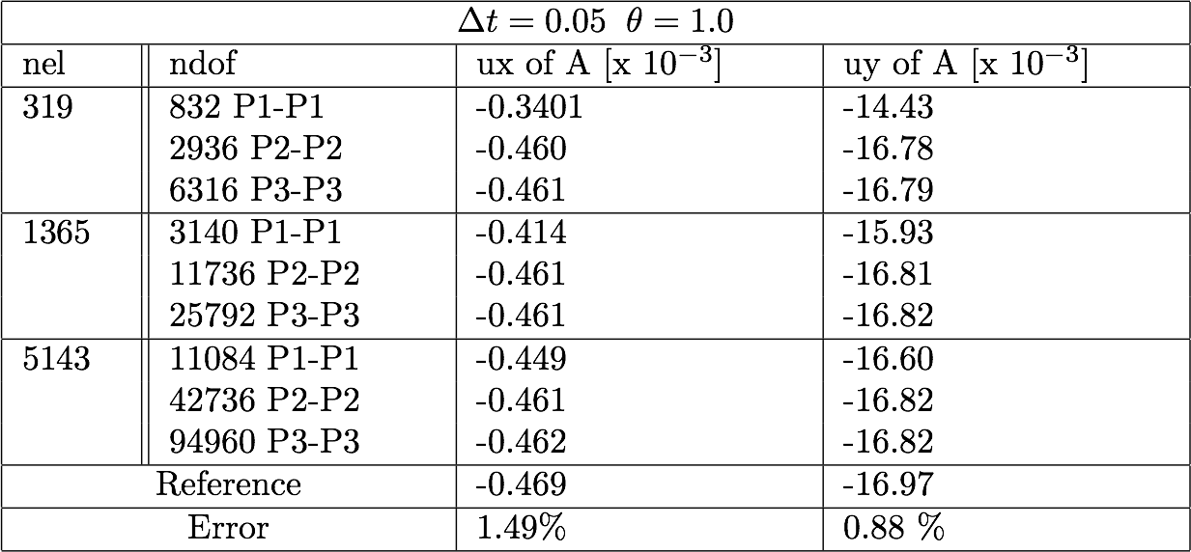
CSM
CSM-1
CSM-3
CSM-2

Slide 17
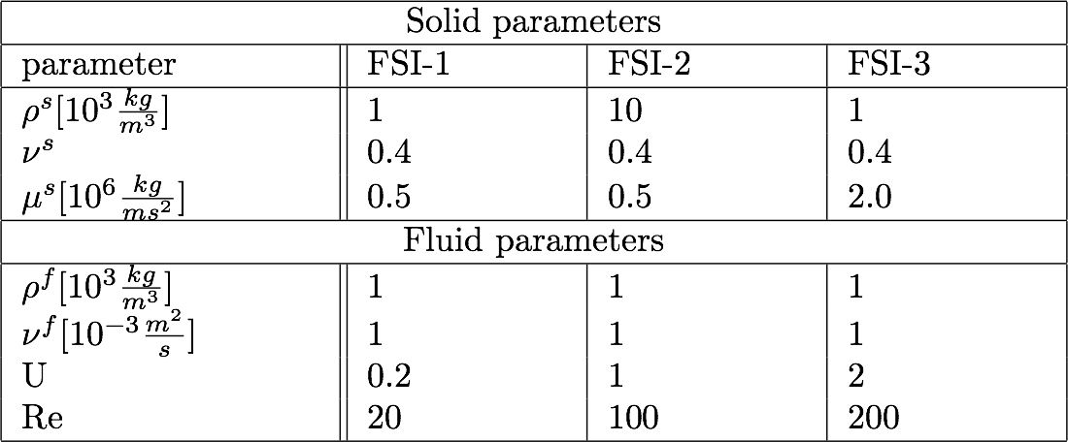
FSI
Fluid and solid equations together with interface coupling
Lift, drag, and deformation of the elastic flag
Comparison of mesh lifting operators

Slide 18
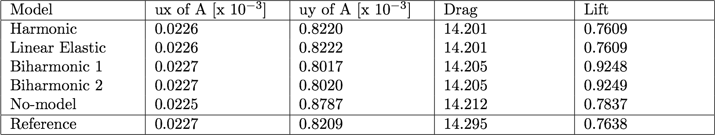
FSI-1
Laminar flow and small deformations
Mesh lifting operator is not essential

Slide 19
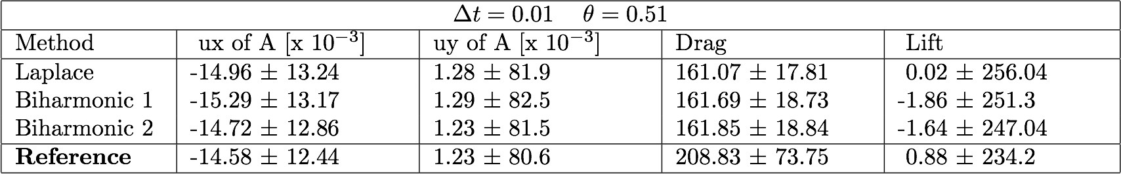
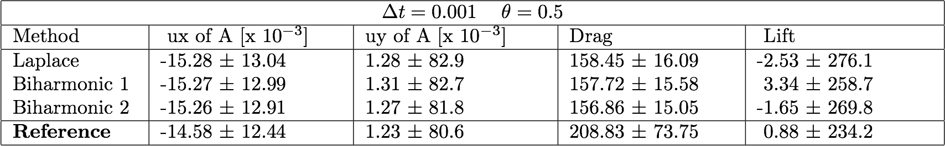

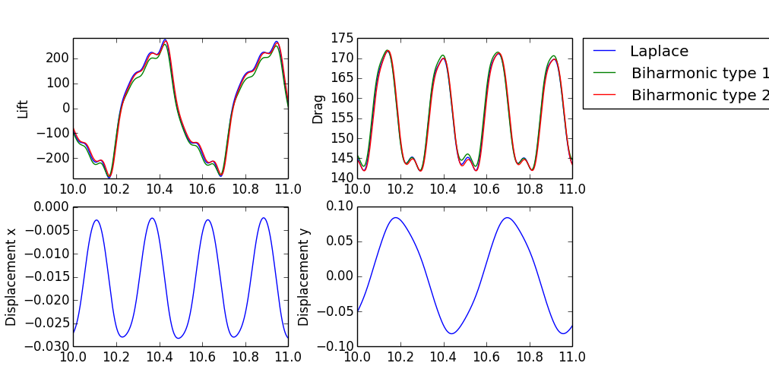
FSI-2
Large deformation

Slide 20

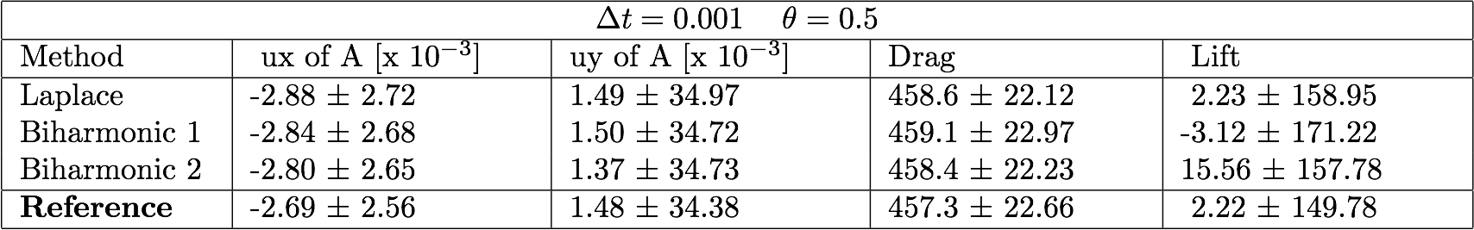
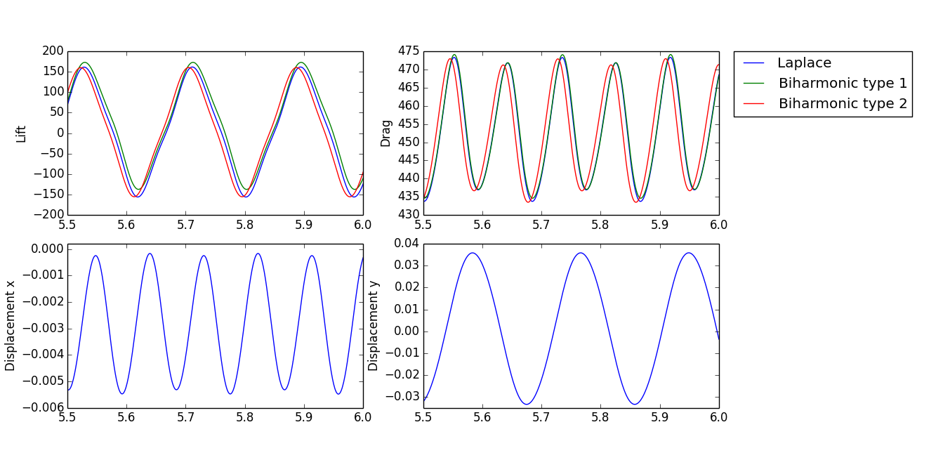
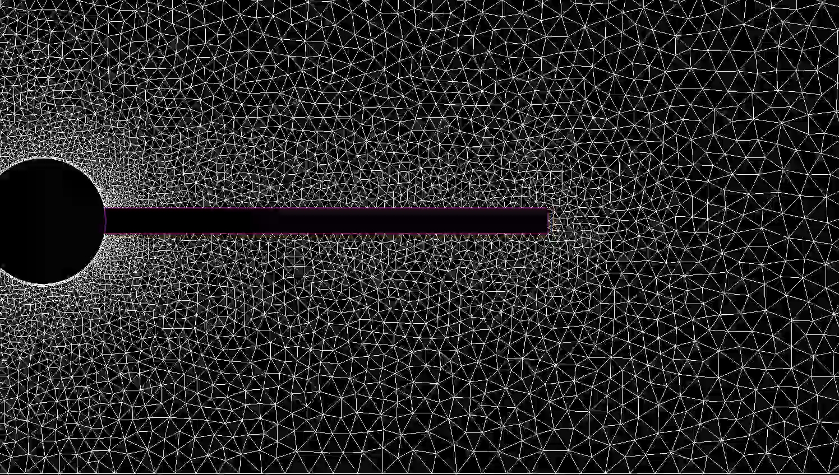
FSI-3
Smaller deformations, but higher Re

Slide 21
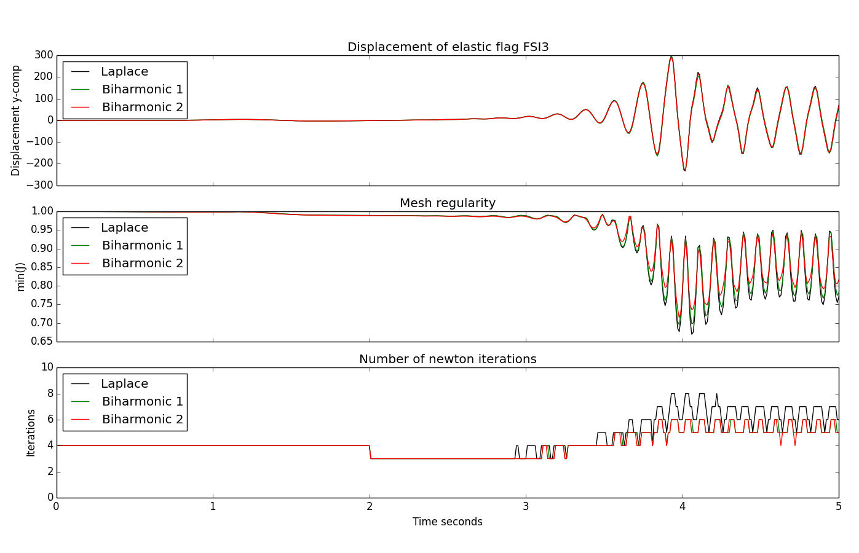
Comparing mesh lifting operators
Comparing displacement, mesh regularity, and newton iterations.

Slide 22
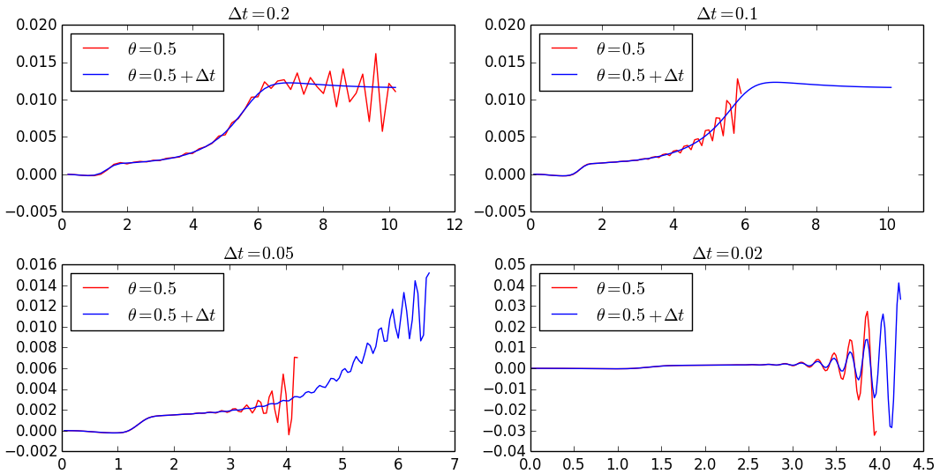
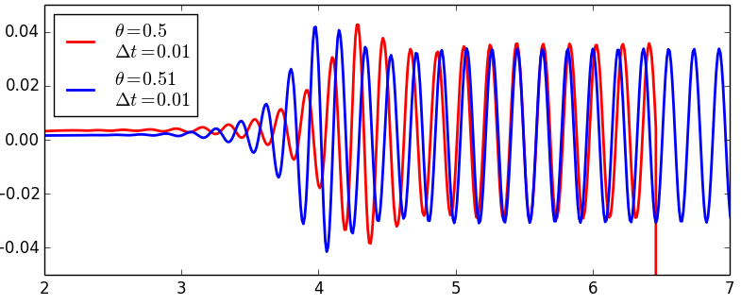
Long-term temporal stability
Centered Crank-Nicholson scheme suffered from long-term temporal stability
A shifted Crank-Nicholson scheme

Slide 23
Long-term temporal stability

Slide 24
Optimisation of Newton solver
The Newton solver uses roughly 98% of total simulation time
The construction of the Jacobian matrix
LU factorization of the linear system
Consistent methods
Jacobi-buffering
Inonsistent methods
Reuse of Jacobian
Quadrature reduce
Combination

Slide 25
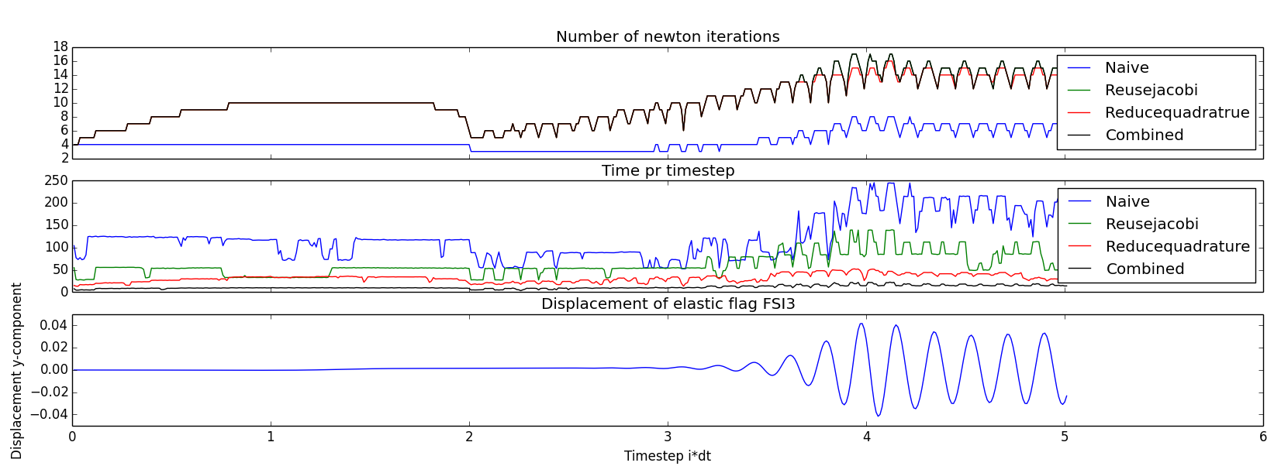
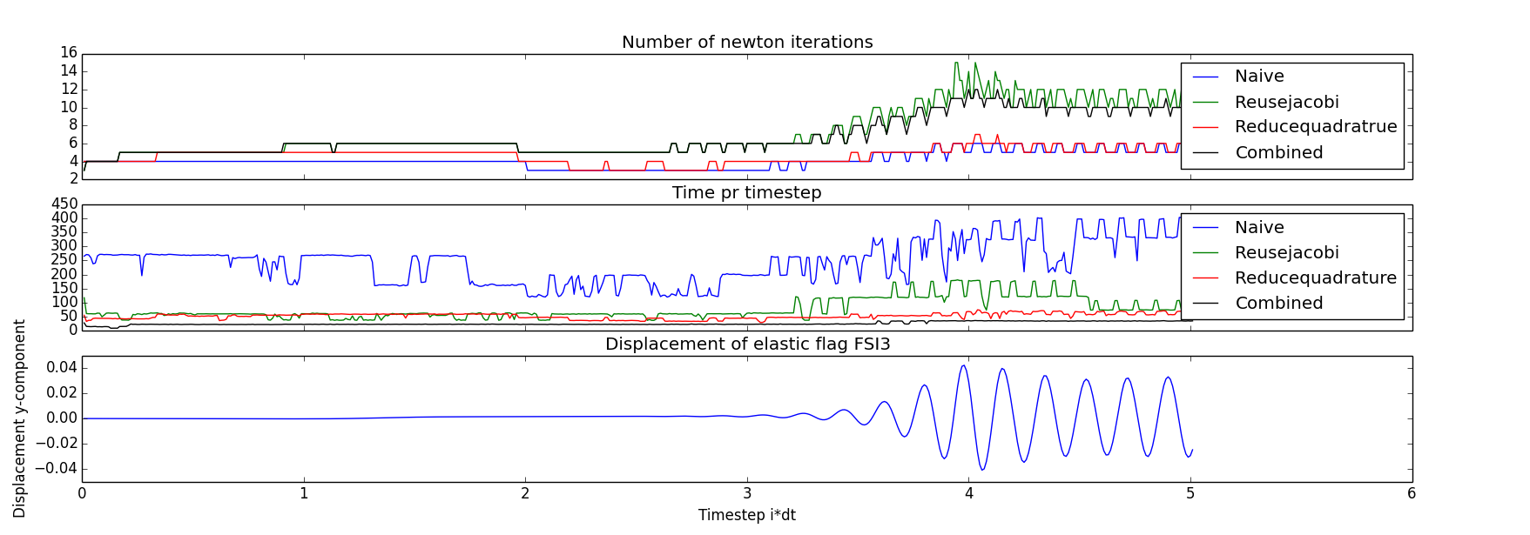
Optimisation of Newton solver
Running FSI-3 with time step 0.01, for T = 5
Comparing Newton iterations, time pr. timestep
Time used pr. timestep
Laplace mesh lifting operator
Biharmonic mesh lifting operator

Slide 26
